Slide 1
Optimal control of a 1D diffusion process with a team of mobile actuators under jointly optimal guidance
Sheng Cheng and Derek A. Paley
University of Maryland
American Control Conference
July 2, 2020
Notes:
\

Slide 2
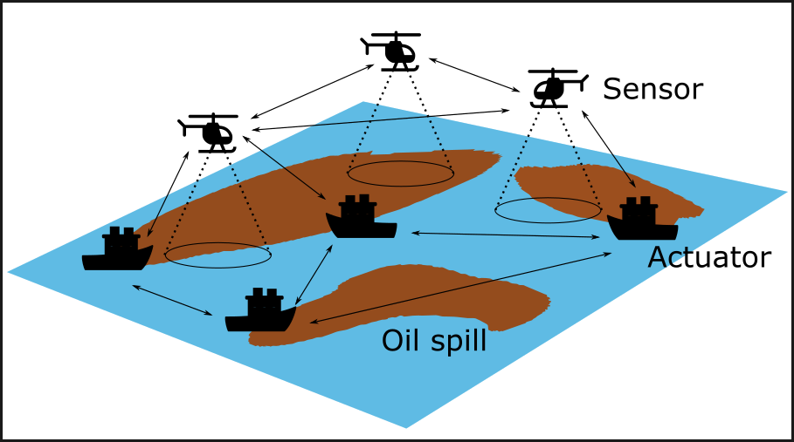
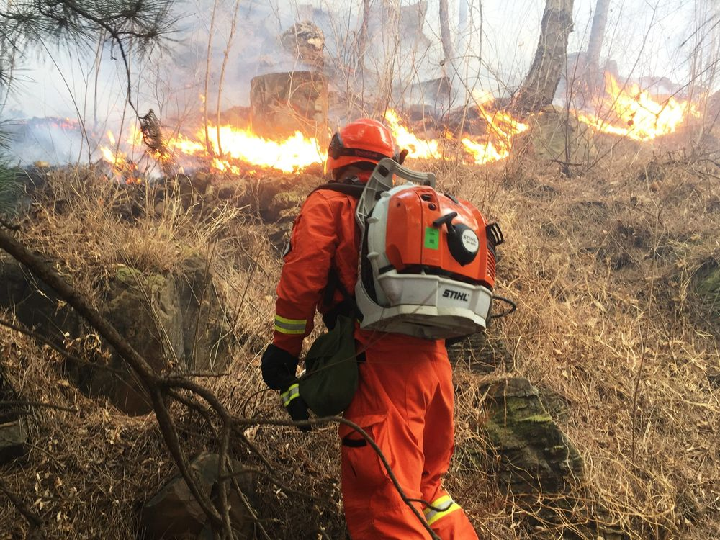
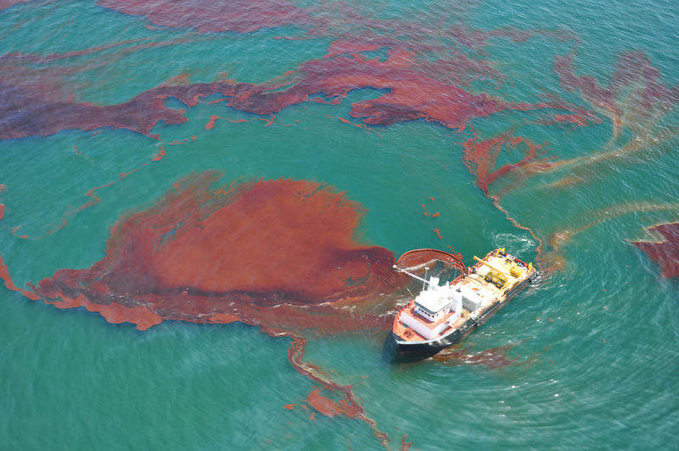
Motivation
Sheng Cheng and Derek A. Paley
Introduction
Formulation
Solution method
Summary
American Control Conference 2020
Monitoring and control of a large-scale spatiotemporal process is dangerous and costly when conducted by humans.
Autonomous vehicles substitute human operators when
equipped with sensors and actuators
guided under designated control policy
Source: www.bloomberg.com
Source: offshore-technology.com
Source: fireaviation.com

Slide 3
Sheng Cheng and Derek A. Paley
Introduction
Formulation
Solution method
Summary
American Control Conference 2020
Relation to prior work and contributions
Actuator type |  | Representative work | Approach
 | Boundary | [Smyshlyaev and Krstic, 2010] | Backstepping
 |  | [Morris, 2010] | LQ
Stationary | In-domain | [Morris et al., 2010] | H₂
 |  | [Demetriou, 2017] | Maximum controllability
Mobile |  | [Demetriou et al., 2003] | LQ
 |  | [Xue and El-Farra, 2018] | LQ
 |  | [Demetriou, 2010] | Lyapunov-based methods
 |  | [Demetriou, 2012] | Lyapunov-based methods
 |  | [Chen et al., 2005] | Centroidal Voronoi tessellation
Contributions of paper:
Formulate an integrated optimization problem to control a PDE with mobile actuators
Show conditions under which optimal guidance restricts the actuators in-domain
Notes:
[Demetriou et al., 2003]: LQ cost with discretized actuator location. The optimization is LQR with infinite horizon
[Xue and El-Farra, 2018]: LQ cost with penalty on sensor-controller communication cost

Slide 4
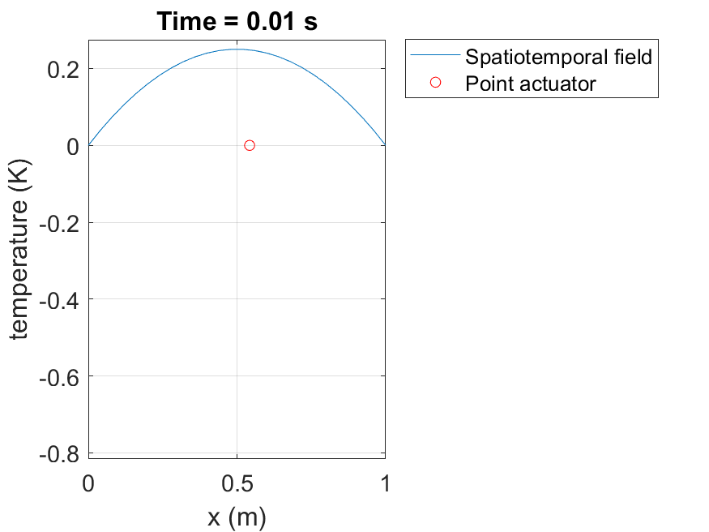
Sheng Cheng and Derek A. Paley
Introduction
Formulation
Solution method
Summary
American Control Conference 2020
Infinite-dimensional system: LQR
Assume linear and first-order dynamics of the mobile actuators
position
guidance
Consider a 1D diffusion equation with known initial condition and zero Dirichlet boundary condition:
Amplitude
PDE state
control
Dirac delta
Abstract linear system representation [Curtain and Zwart, 1995]
Notes:
Label y axis

Slide 5
Sheng Cheng and Derek A. Paley
Introduction
Formulation
Solution method
Summary
American Control Conference 2020
Infinite-dimensional system: LQR (cont.)
Abstract linear system representation of a PDE
Linear-quadratic regulator formulation
state cost
control effort
terminal state cost
Linear-quadratic optimal control:
with operator-valued differential Riccati equation [Bensoussan et al. 2007]:

Slide 6
Sheng Cheng and Derek A. Paley
Introduction
Formulation
Solution method
Summary
American Control Conference 2020
Problem formulation
Find actuation control $u$ and actuator guidance $p$ that solve
with
PDE-related cost
Mobility-related cost

Slide 7
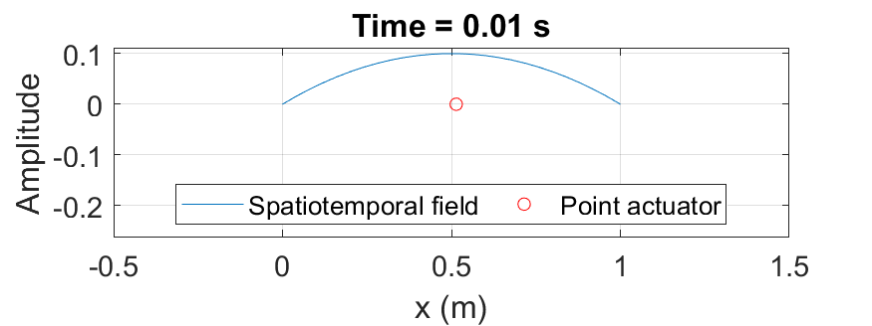
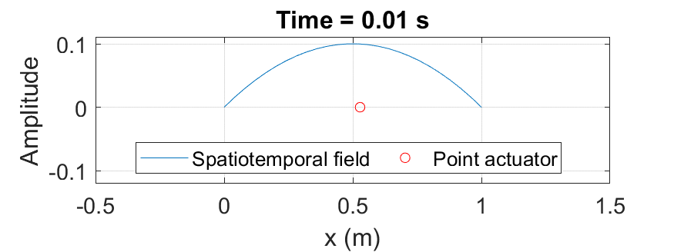
Sheng Cheng and Derek A. Paley
Introduction
Formulation
Solution method
Summary
American Control Conference 2020
Optimal guidance: Actuators stay in domain
Problem (P) does not have an explicit constraint on actuators staying within the spatial domain.
🙂
☹️
An optimal guidance will guarantee the actuators to stay within the spatial domain under certain conditions.
Notes:
Remove last comma

Slide 8
Sheng Cheng and Derek A. Paley
Introduction
Formulation
Solution method
Summary
American Control Conference 2020
Optimal guidance: Actuator stay in domain (cont.)
Theorem Consider problem (P) with the following assumptions:
Single integrator dynamics of the actuators:
State running cost of the actuators is zero:
Initial locations of the actuators are in domain:
Either, terminal locations are in domain:
or, no terminal cost for the actuators:
Then, any guidance that steers the mobile actuators out of the domain is not optimal.
Sketch of proof:
Start with arbitrary guidance that steers one actuator outside the domain.
Construct the second guidance that always restricts the actuator in the domain using first guidance.
The second guidance always incurs smaller cost than the first guidance.

Slide 9
Sheng Cheng and Derek A. Paley
Introduction
Formulation
Solution method
Summary
American Control Conference 2020
Solution method: Approximated problem
Galerkin approximation
Consider the approximated version of the problem:
with approximated PDE-related cost
(P1-A) is not an LQR: $B_{ξ,N}$ is a nonlinear function of $ξ$.

Slide 10
Sheng Cheng and Derek A. Paley
Introduction
Formulation
Solution method
Summary
American Control Conference 2020
Solution method: Pontryagin’s maximum principle
Hamiltonian:
co-state dynamics
terminal conditions
optimality conditions
Notes:
Remove commas

Slide 11
Sheng Cheng and Derek A. Paley
Introduction
Formulation
Solution method
Summary
American Control Conference 2020
Solutions: open-loop vs. feedback control
Original problem (P)
Galerkin approximation
Approximated problem (AP)
Feedback control synthesized using LQR:
PMP
Optimal open-loop guidance
Optimal open-loop control
LQR of
PDE
Optimal feedback control
Optimal trajectory

Slide 12
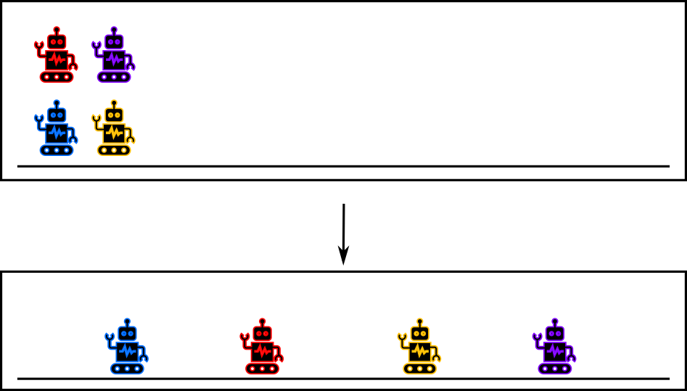
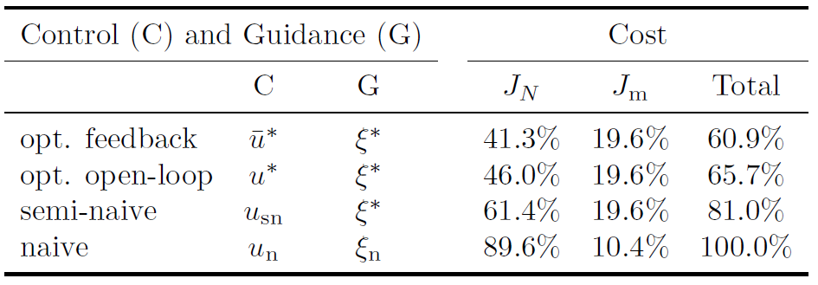
Sheng Cheng and Derek A. Paley
Introduction
Formulation
Solution method
Summary
American Control Conference 2020
Numerical example
Four mobile actuators：
initiated at one location
evenly spaced terminal locations.
Feedback control synthesized using LQR
Comparison groups:
Name | Control and guidance
Optimal feedback | Optimal feedback control with optimal open-loop guidance
Optimal open-loop | Optimal open-loop control with optimal open-loop guidance
Semi-naive | Output feedback control with optimal open-loop guidance
Naive | Output feedback control with constant speed guidance
Notes:
Label y axis of animation
2 slides: explain the comparison
animation on left and figures on right (second page)

Slide 13
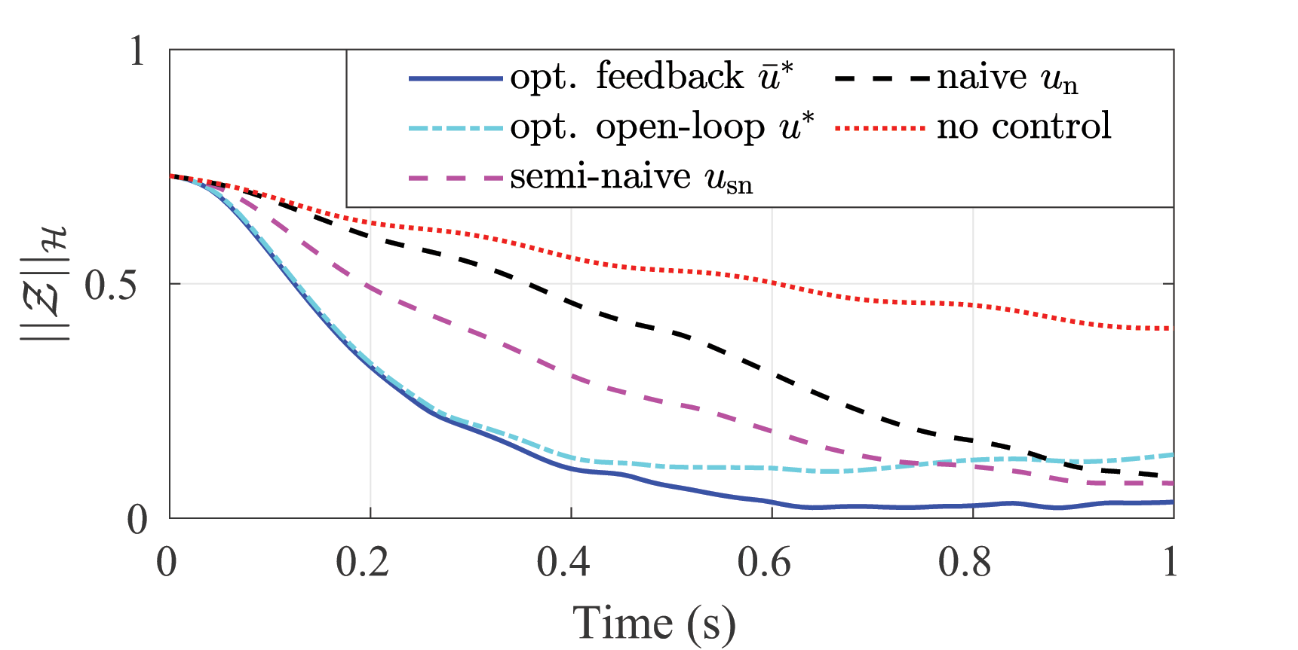
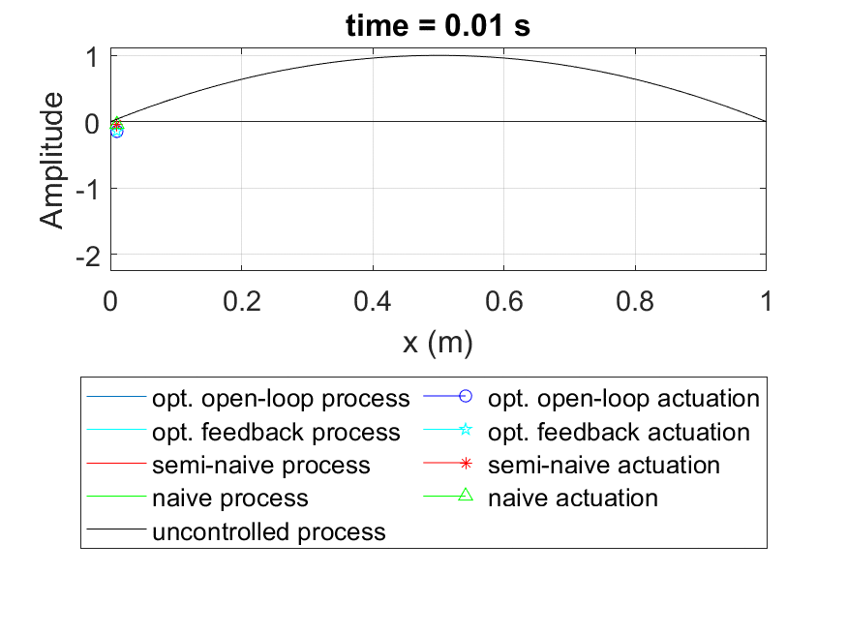
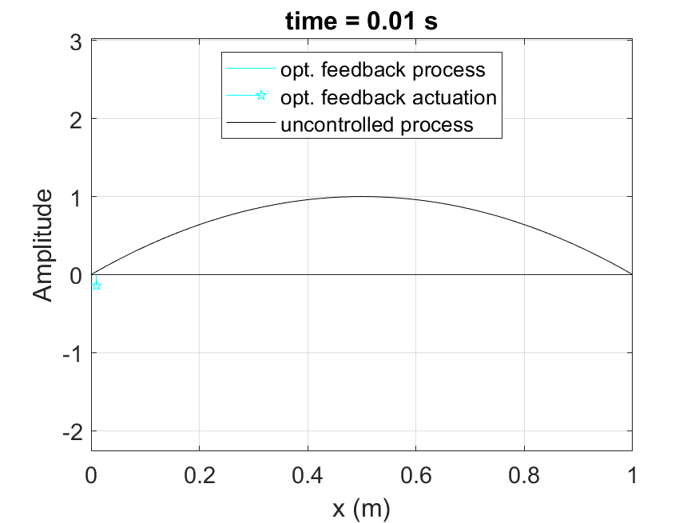
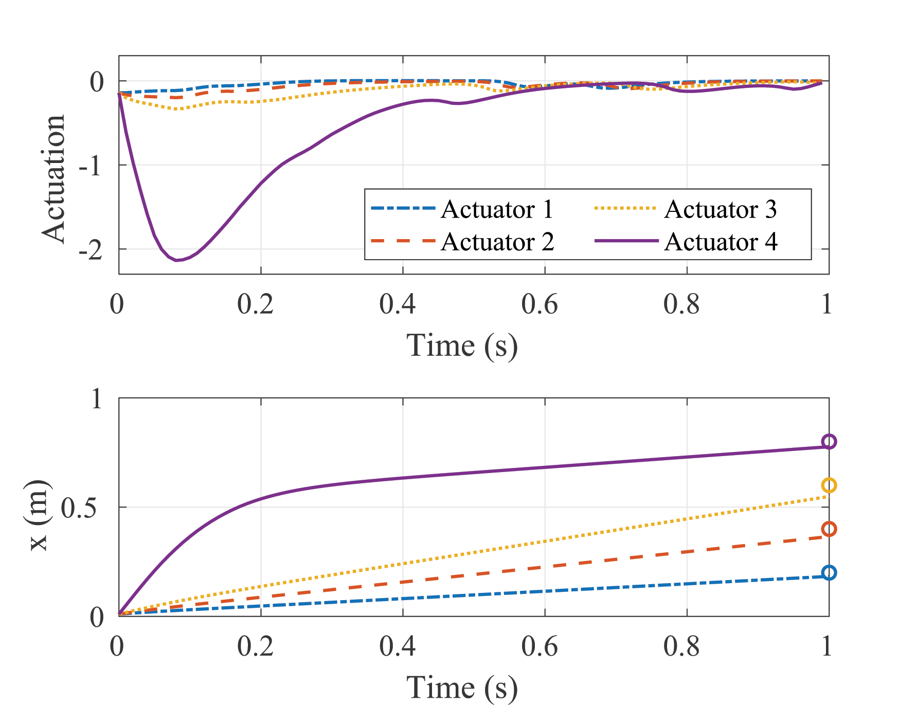
Sheng Cheng and Derek A. Paley
Introduction
Formulation
Solution method
Summary
American Control Conference 2020
Numerical example (cont.)
Notes:
Label y axis of animation
2 slides: explain the comparison
animation on left and figures on right (second page)

Slide 14
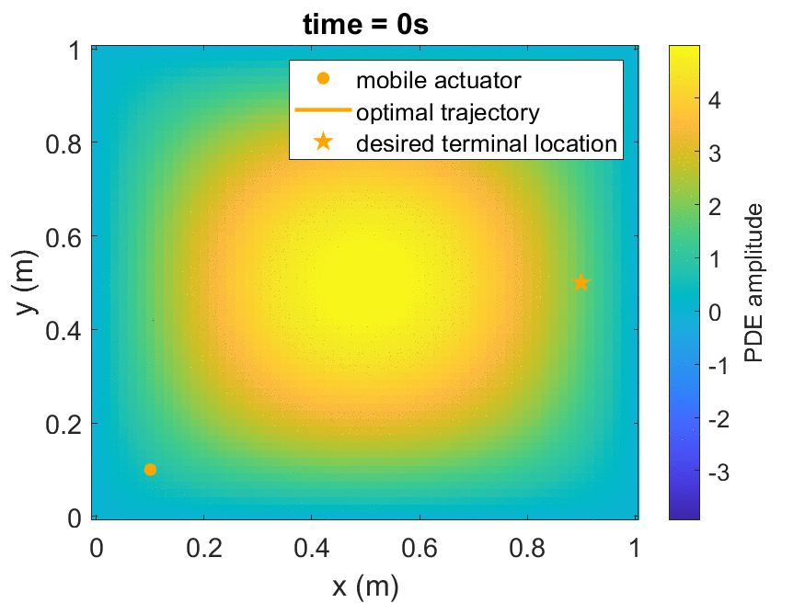
Sheng Cheng and Derek A. Paley
Introduction
Formulation
Solution method
Summary
American Control Conference 2020
Summary and ongoing work
Optimal control of a diffusion process using a team of mobile actuators under jointly optimal guidance
Ongoing work
Extend the framework to diffusion-advection process with 2D spatial domain
More efficient numerical computation
Convergence of the solution of the approximated problem (AP)
Simultaneous estimation and control with a team of mobile sensor-plus-actuators.
Notes:
Add slides (1-3) with details on Ongoing work

Slide 15
Sheng Cheng and Derek A. Paley
Introduction
Formulation
Solution method
Summary
American Control Conference 2020
Thank you!
This work is supported by DARPA Contract No. HR001118C0142
cheng@terpmail.umd.edu

